Slide 1

Department of Computer Science & Engineering
StellarStudent
Date: 27th May 2021
Tarani Talluri : 17wh1a0576
Raga Rasagna P : 17wh1a0599
Pravallika M.N : 18wh5a0517
Internal Guide: Dr. N. Sreekanth
Designation: Associate Professor
BVRIT HYDERABAD College of Engineering for Women

Slide 2
Abstract
StellarStudent is a web application that deals with student and faculty.
Faculty and Admin can perform several operations like adding students, view all student details, viewing students certifications, share information about meetings and events, they can also add quizzes, course materials, latest updates.
Student can respond to all the actions given by the faculty.
Students can upload their certificates, attempt quizzes and view quiz results, they can check courses and subject materials uploaded by the faculty, they can view information about meetings, events and placements drives.
We also provided chat option to the students and faculty can also participate in discussions.
BVRIT HYDERABAD College of Engineering for Women

Slide 3
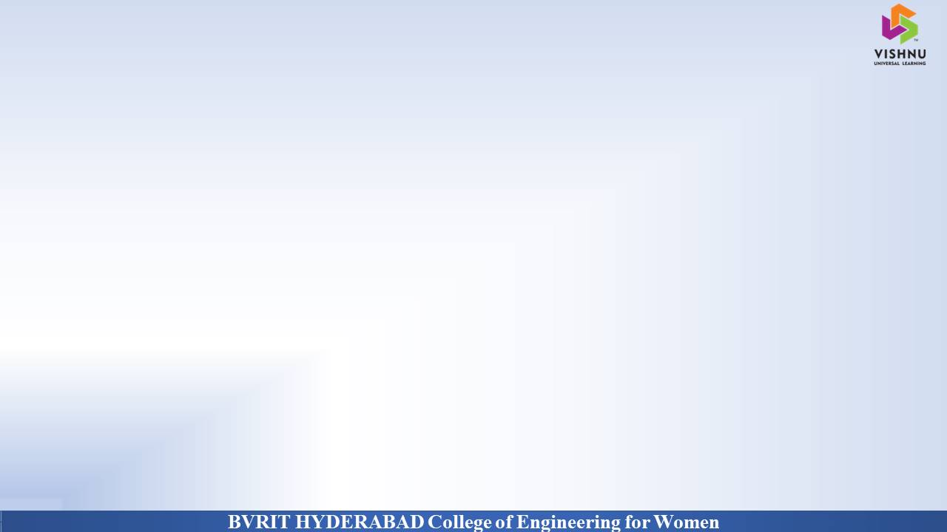
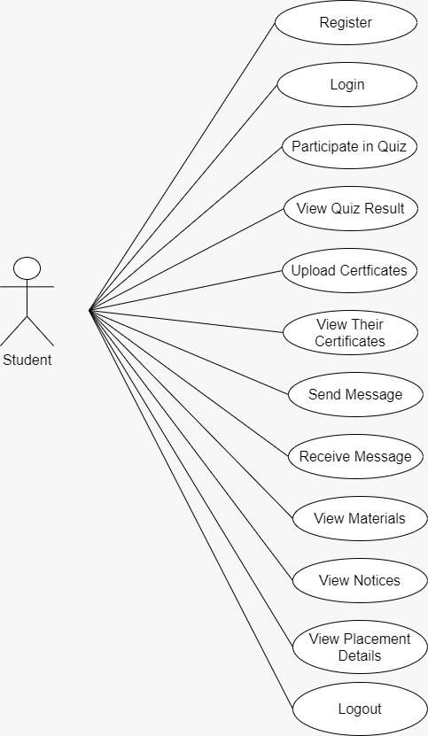
Why Should I Study this course?
StellarStudent :: Use Case Diagram of Student
Examples
BVRIT HYDERABAD College of Engineering for Women

Slide 4
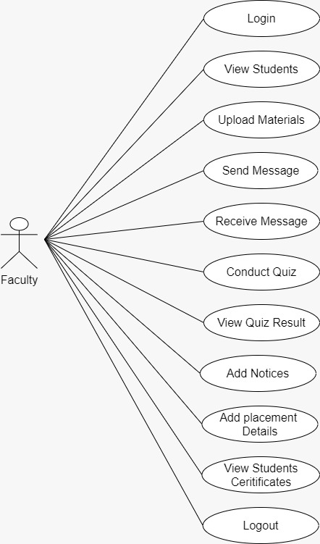
StellarStudent :: Use Case Diagram of Faculty

Slide 5
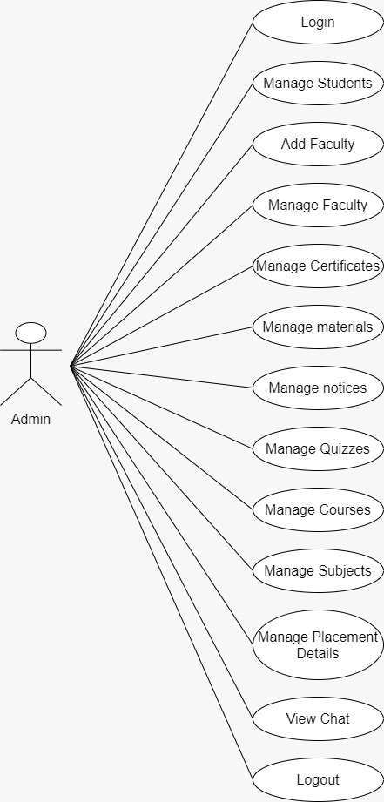
StellarStudent :: Use Case Diagram of Admin

Slide 6
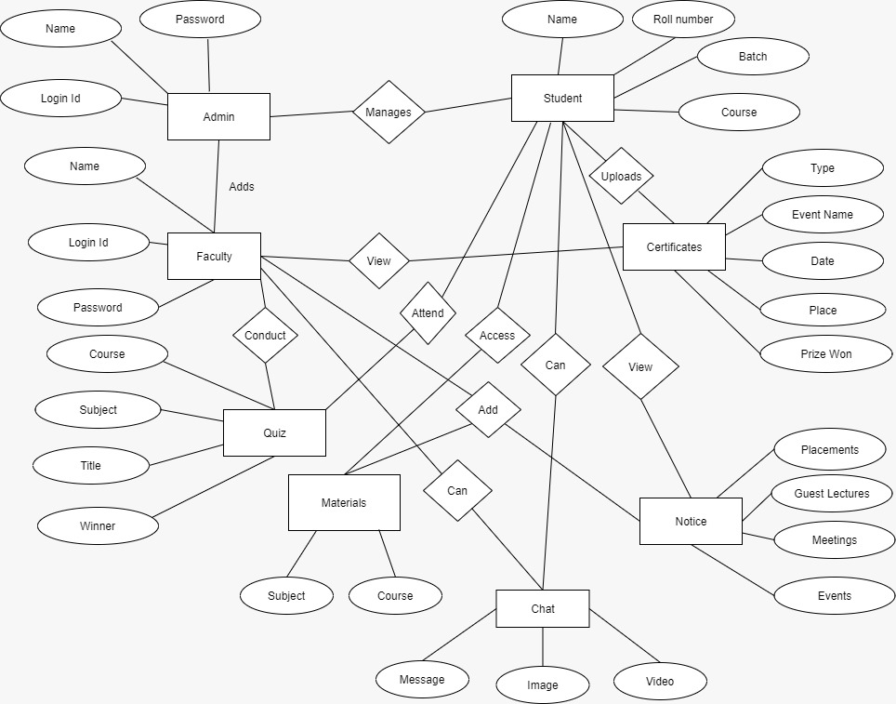
ER Diagram
BVRIT HYDERABAD College of Engineering for Women

Slide 7
Testing
Testing is the major quality control measure used during software development. It is a basic function to detect errors in the software. During the requirement analysis and design the output of the document that is usually textual and non-executable after the coding phase the computer programs are available that can be executed for testing purpose. This implies that testing not only has to uncover errors introduce during the previous phase. The goal of testing is to uncover requirement, design, coding errors in the program.
Manual Testing: The process of testing the application manually, in a repeated way to find a defect these are the three manual testing methods which we used on our application
Unit Testing
Integration Testing
System Testing

Slide 8
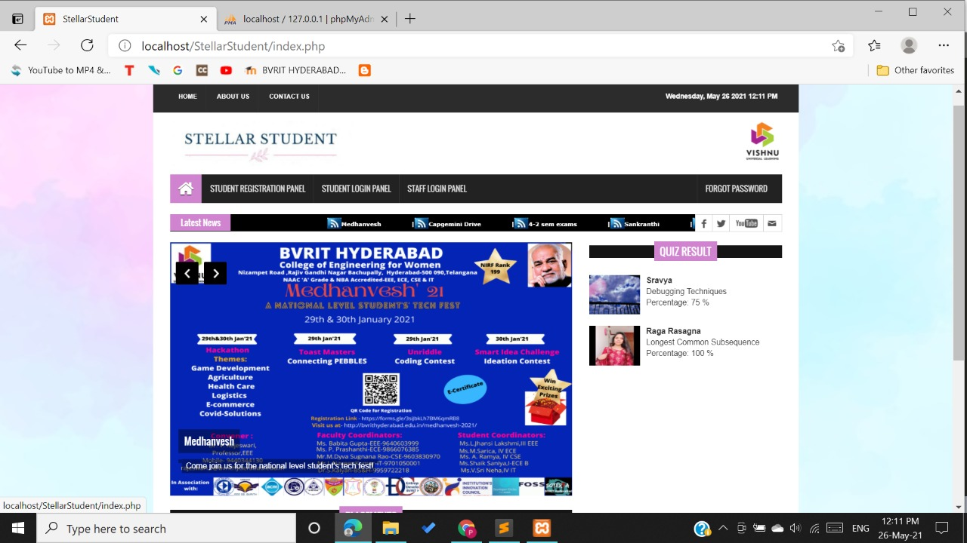
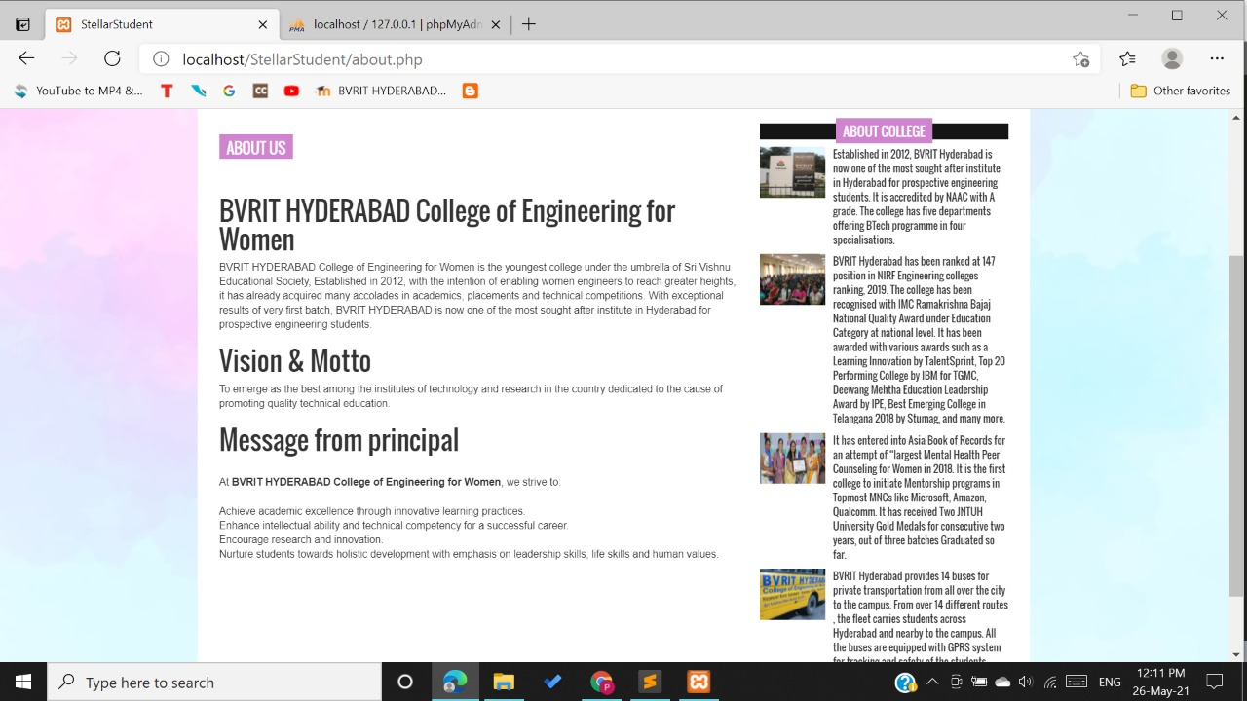
Output

Slide 9
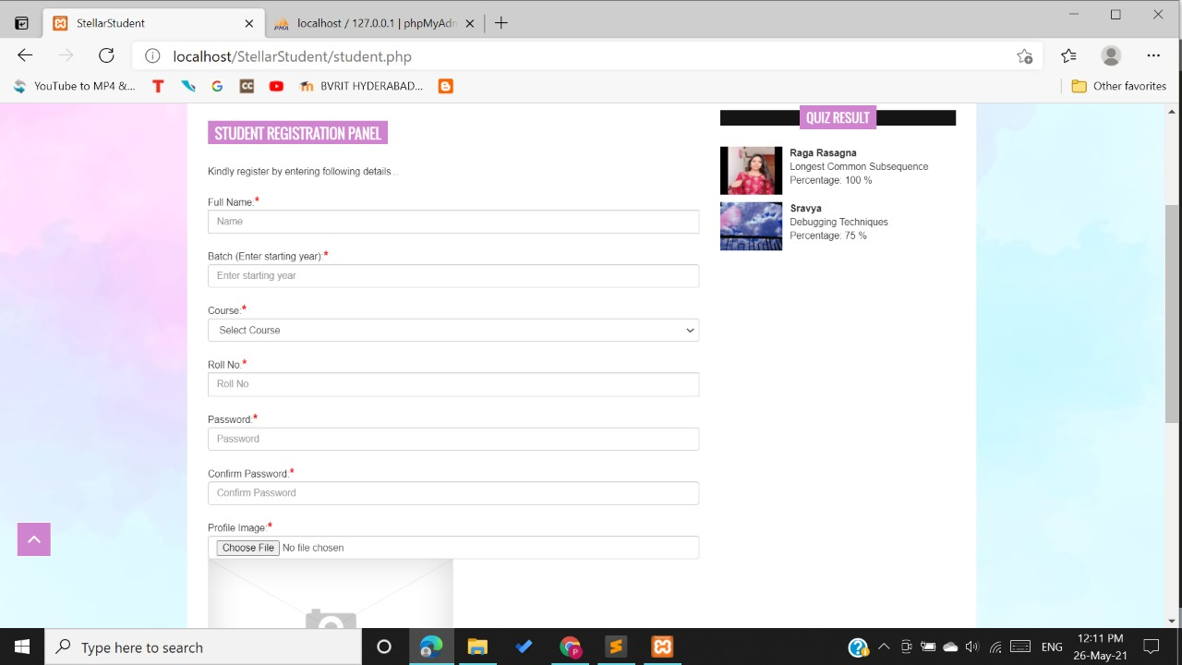
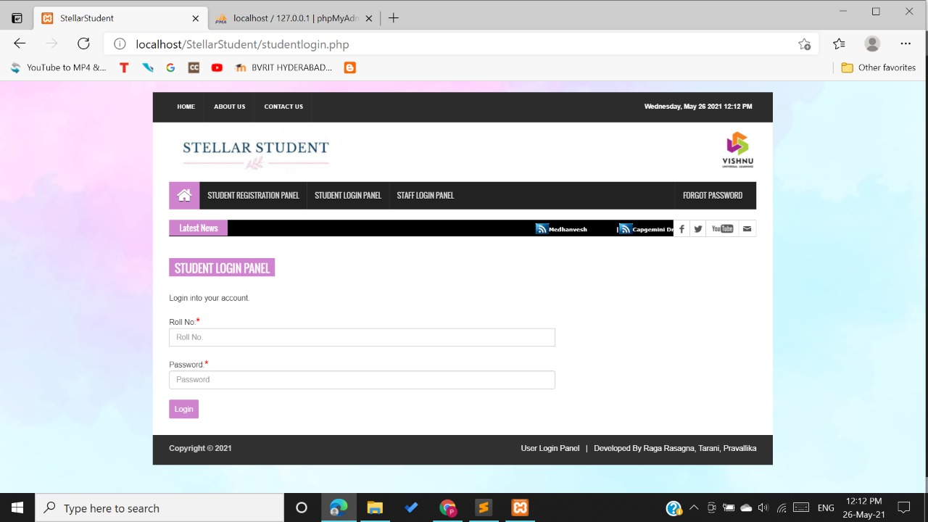

Slide 10
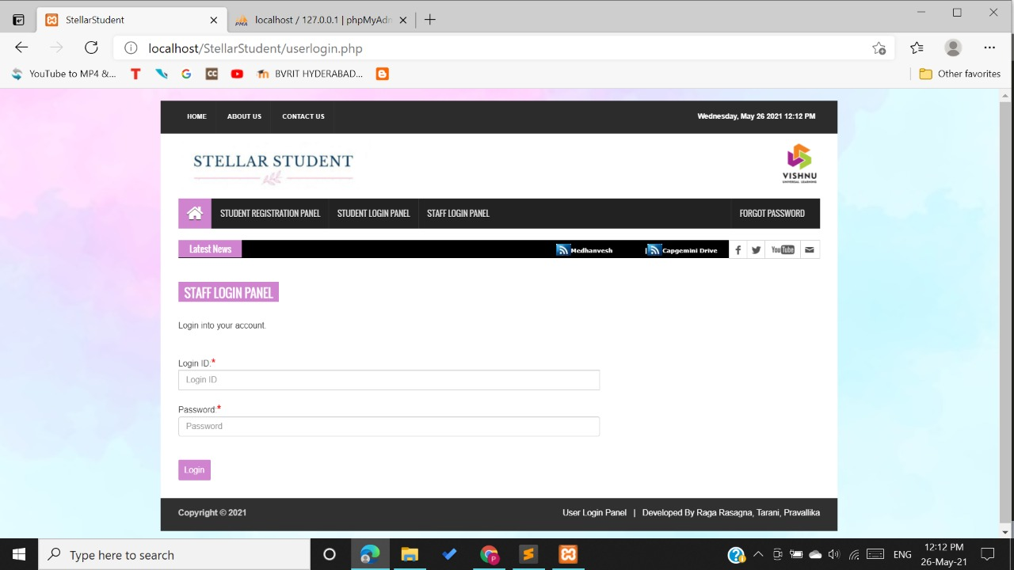
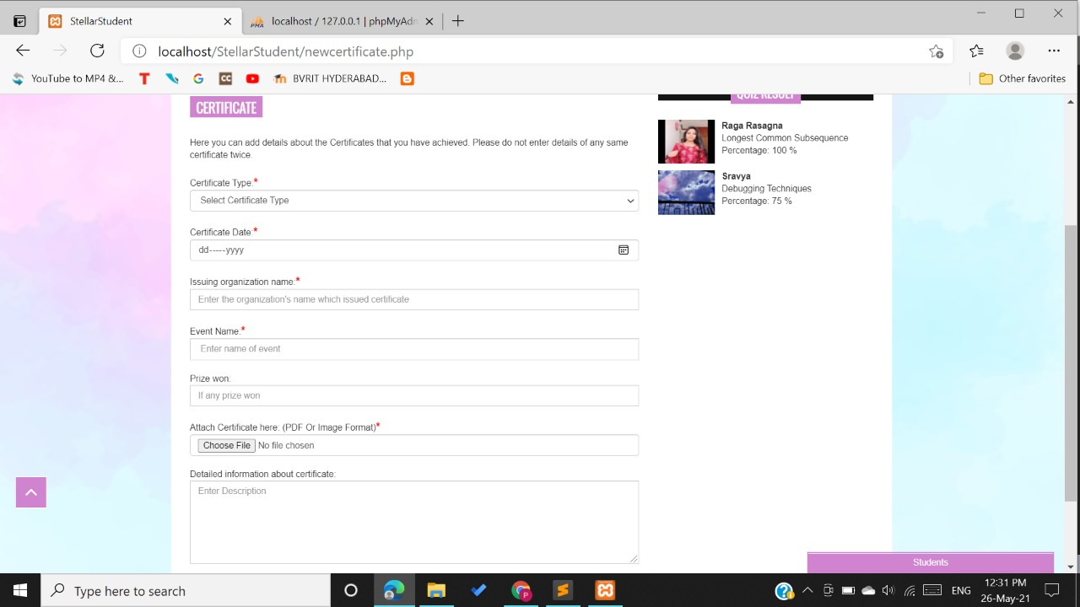

Slide 11
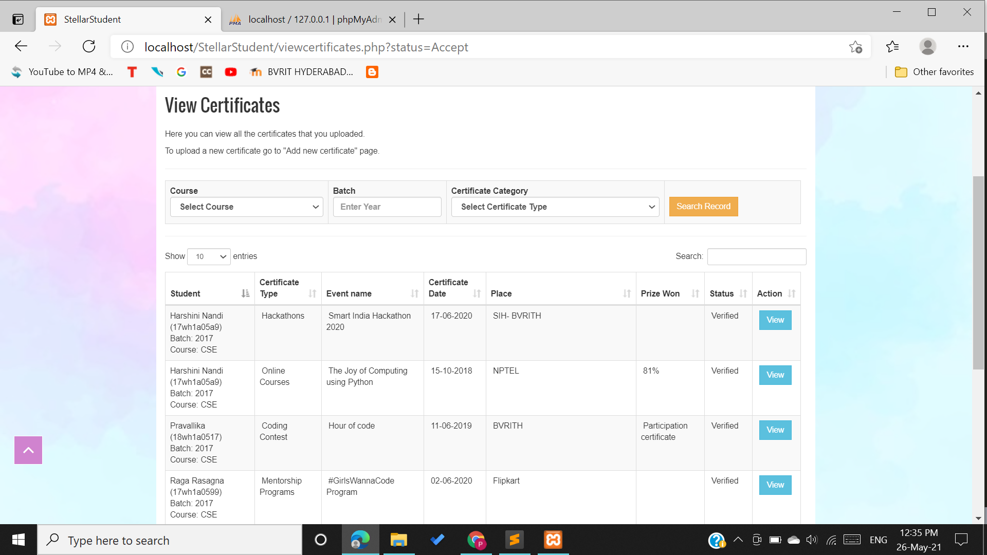

Slide 12
Tools and Technologies
Environment | Specification
Hardware | Processor - Intel Core i3 OS: Windows 8 and above Memory(RAM) - 4 GB Storage – 50 GB or more
Software | XAMPP 1.8.2 Sublime Text 3 MYSQL Server 5.4 Star UML Browser: Microsoft Edge, Google Chrome, Mozilla Firefox
BVRIT HYDERABAD College of Engineering for Women

Slide 13
Thank You
BVRIT HYDERABAD College of Engineering for Women

